Slide 1
UPPER SIXTH ARTS
GEOGRAPHY
Lesson 5
Population Structure
Notes:
Good morning, class, and welcome to our geography lesson. I am your geography teacher, Mr Kamdem. Today we are starting Lesson 5: Population Structure.

Slide 2
CLASS INFO
Class, Chapter and Duration
Class | Upper Sixth Arts
Chapter | Module 4: Understanding and managing population dynamics across the world in general and Cameroon in particular
Duration | 2 periods (2 × 50 minutes)
Notes:
This lesson is for Upper Sixth Arts. It belongs to Module 4: Understanding and managing population dynamics across the world in general and Cameroon in particular. We shall need 2 periods to cover it.

Slide 3
IDENTIFICATION
Lesson Identification
Topic | Population Structure and Composition
Sub-topic | Meaning of Population Structure
Lesson | Lesson 5: Population Structure
Notions / Concepts | Population structure (composition), demographic structure, socio-political structure, economic structure, active population, dependent population, occupational structure.
Syllabus focus | Meaning of the composition (structure) of population; the demographic, socio-political and economic components; importance of population structure.
Competence | Learners are able to describe the components of population structure and use them to explain local needs such as schools, jobs and health services.
Notes:
Our topic is Population Structure and Composition, and the sub-topic is Meaning of Population Structure. The key notions we shall use today are: population structure (composition), demographic structure, socio-political structure, economic structure, active population, dependent population, occupational structure. At the end, you should be able to do this: learners are able to describe the components of population structure and use them to explain local needs such as schools, jobs and health services.

Slide 4

HOMEWORK CORRECTION
Correction of the Homework
Question (Lesson 4: Modifications of Population Distribution):
List the three main age groups of a population.
Notes:
Before we start the new lesson, let us correct the homework I gave you at the end of Lesson 4: Modifications of Population Distribution. The question was: List the three main age groups of a population. Take out your exercise books.

Slide 5
HOMEWORK CORRECTION
Correction: Possible Answer
The young (0–14 years), the adults of working age (15–64 years) and the elderly (65 years and over).
Notes:
Here is a good answer. The young (0–14 years), the adults of working age (15–64 years) and the elderly (65 years and over). Compare it with your own answer and correct your work in red.

Slide 6
LESSON PLAN
Lesson Plan
Correction of the homework
Objectives and recall
Real-life situation and action to take
Learning activities
Board summary
Evaluation, remediation and homework
Notes:
Here is the plan of our lesson today. First, we shall correct the homework. Then we shall look at the objectives and recall what you already know. After that, we shall study a situation from real life and the action to take, and do the learning activities. Finally, we shall copy the board summary, do the evaluation and the remediation, and I will give you the homework.

Slide 7
OBJECTIVES
Objectives
By the end of this lesson, you should be able to:
Define population structure (composition).
Describe the demographic structure.
Describe the socio-political structure.
Describe the economic structure.
Notes:
Take your time to copy this part; we will continue together.

Slide 8
OBJECTIVES
Objectives (continued)
Explain the importance of population structure for planning.
Notes:
By the end of this lesson, you should be able to do five things. Number 1: define population structure (composition). Number 2: describe the demographic structure. Number 3: describe the socio-political structure. Number 4: describe the economic structure. Number 5: explain the importance of population structure for planning.

Slide 9
PREVIOUS KNOWLEDGE
Previous Knowledge
A census records age, sex, religion and occupation.
People migrate from villages to towns.
Towns offer many service jobs.
Notes:
Let us first remember what you already know. A census records age, sex, religion and occupation. People migrate from villages to towns. Towns offer many service jobs. Keep this in mind, because we shall build on it today.

Slide 10
REAL-LIFE SITUATION
Situation in Real Life
On a busy Monday morning at the Central Market of Garoua, you see young boys pushing "pousse-pousse", women selling vegetables and folléré, and elderly men drinking tea.
You hear Fulfulde, French, Moundang and Hausa, and on Friday the movement of people changes because of prayers.
Notes:
Take your time to copy this part; we will continue together.

Slide 11
REAL-LIFE SITUATION
Situation in Real Life (continued)
The Mayor wonders whether to build more schools or to create more jobs.
He asks: "Who exactly are the people of Garoua, and why is it important to know them?"
Notes:
Listen carefully to this situation from real life. On a busy Monday morning at the Central Market of Garoua, you see young boys pushing "pousse-pousse", women selling vegetables and folléré, and elderly men drinking tea. You hear Fulfulde, French, Moundang and Hausa, and on Friday the movement of people changes because of prayers. The Mayor wonders whether to build more schools or to create more jobs. He asks: "Who exactly are the people of Garoua, and why is it important to know them?" Think about it, because I am going to ask you some questions.

Slide 12
REAL-LIFE SITUATION
Situation: Question 1
What is the problem in the situation?
Notes:
Question 1: What is the problem in the situation? Think for a moment, then raise your hand to answer.

Slide 13
REAL-LIFE SITUATION
Answer
The Mayor does not know the structure of the population of Garoua and why it matters.
Notes:
Good. The Mayor does not know the structure of the population of Garoua and why it matters.

Slide 14
REAL-LIFE SITUATION
Situation: Question 2
Are all the people in the market of the same age and activity?
Notes:
Question 2: Are all the people in the market of the same age and activity? Think for a moment, then raise your hand to answer.

Slide 15
REAL-LIFE SITUATION
Answer
No, there are children, adults and old people doing different activities.
Notes:
Good. No, there are children, adults and old people doing different activities.

Slide 16
REAL-LIFE SITUATION
Situation: Question 3
What does a geographer call this mix of people?
Notes:
Question 3: What does a geographer call this mix of people? Think for a moment, then raise your hand to answer.

Slide 17
REAL-LIFE SITUATION
Possible Answer
Population structure (or population composition).
Notes:
Good. Population structure (or population composition).

Slide 18
ACTION TO TAKE
Action to Take
Use the structure of the population of your area to identify its main needs (schools, jobs, health care).
Notes:
From this situation, the action we are working towards in this lesson is the following: use the structure of the population of your area to identify its main needs (schools, jobs, health care).

Slide 19
JUSTIFICATION
Justification of the Lesson
This lesson helps us to understand the make-up of a population, which guides the planning of schools, health services and jobs.
Notes:
Why is this lesson important for you? This lesson helps us to understand the make-up of a population, which guides the planning of schools, health services and jobs.

Slide 20
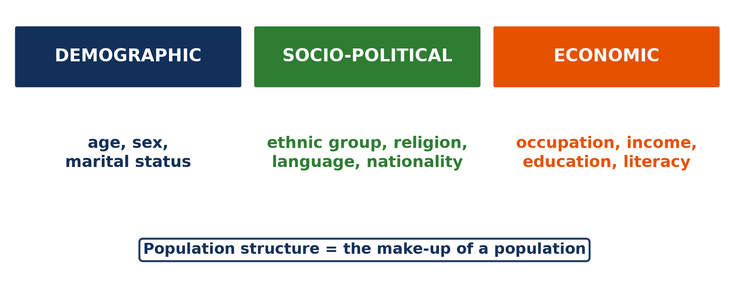
1. MEANING
Activity 1
The three components of population structure.
Notes:
Activity 1. Look carefully at this diagram: the three components of population structure. Observe every detail before I ask the question.

Slide 21
1. MEANING
Activity 1: Question
Name the three components of population structure.
Notes:
Here is the question for Activity 1: Name the three components of population structure. Take one minute to think and write your answer in your rough notebook.

Slide 22
1. MEANING
Activity 1: Answer
The demographic, the socio-political and the economic structures.
Notes:
Let us check the answer together. The demographic, the socio-political and the economic structures.

Slide 23

2. DEMOGRAPHIC STRUCTURE
Activity 2
Children at school.
Notes:
Activity 2. Look carefully at this picture: children at school. Observe every detail before I ask the question.

Slide 24
2. DEMOGRAPHIC STRUCTURE
Activity 2: Question
Which age group needs schools and vaccinations?
Notes:
Here is the question for Activity 2: Which age group needs schools and vaccinations? Take one minute to think and write your answer in your rough notebook.

Slide 25
2. DEMOGRAPHIC STRUCTURE
Activity 2: Answer
The young dependants (0–14 years).
Notes:
Let us check the answer together. The young dependants (0–14 years).

Slide 26

2. SOCIO-POLITICAL STRUCTURE
Activity 3
A busy market.
Notes:
Activity 3. Look carefully at this picture: a busy market. Observe every detail before I ask the question.

Slide 27
2. SOCIO-POLITICAL STRUCTURE
Activity 3: Question
Name two languages spoken in the market of Garoua.
Notes:
Here is the question for Activity 3: Name two languages spoken in the market of Garoua. Take one minute to think and write your answer in your rough notebook.

Slide 28
2. SOCIO-POLITICAL STRUCTURE
Activity 3: Answer
Fulfulde, French, Moundang or Hausa (any two).
Notes:
Let us check the answer together. Fulfulde, French, Moundang or Hausa (any two).

Slide 29
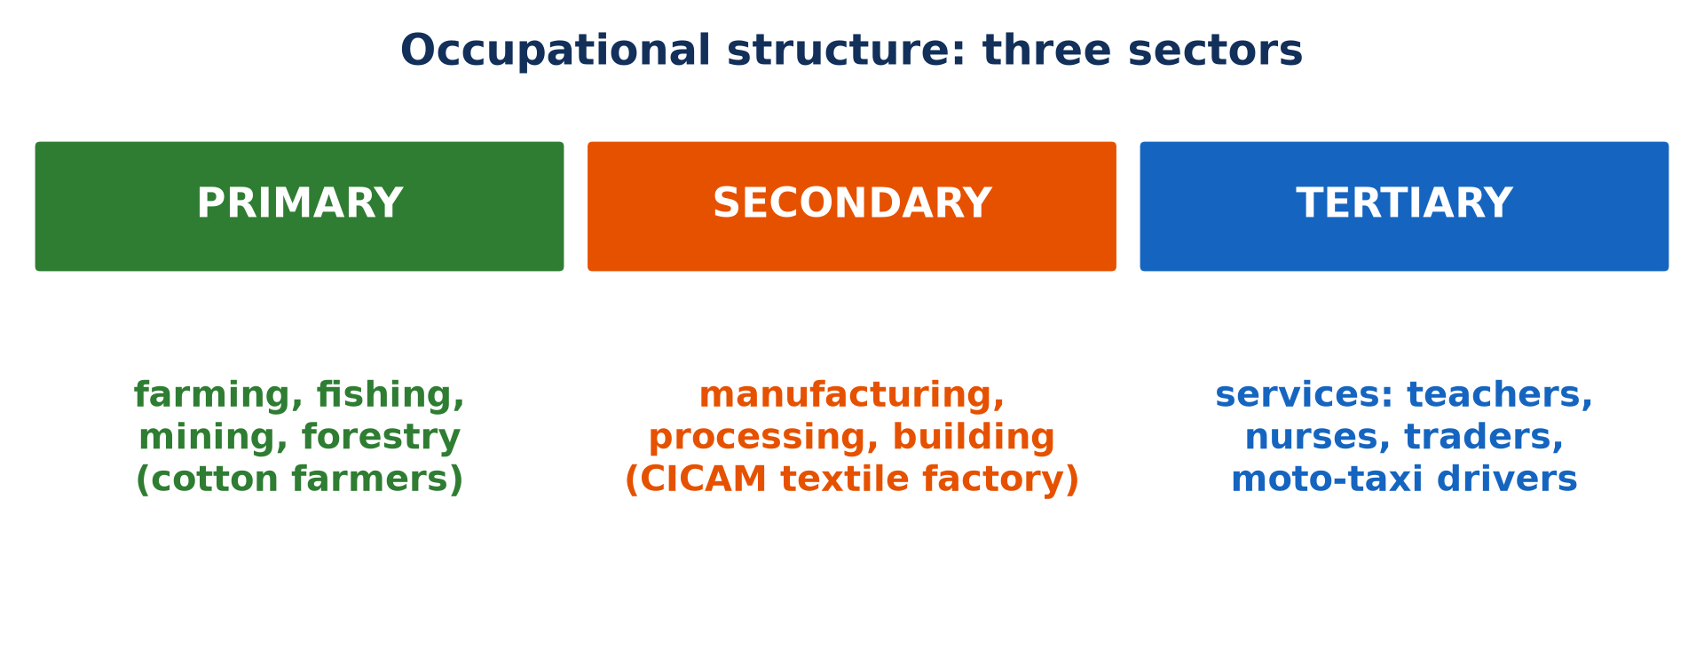
2. ECONOMIC STRUCTURE
Activity 4
The three sectors of activity.
Notes:
Activity 4. Look carefully at this picture: the three sectors of activity. Observe every detail before I ask the question.

Slide 30
2. ECONOMIC STRUCTURE
Activity 4: Question
In which sector does a moto-taxi driver work?
Notes:
Here is the question for Activity 4: In which sector does a moto-taxi driver work? Take one minute to think and write your answer in your rough notebook.

Slide 31
2. ECONOMIC STRUCTURE
Activity 4: Answer
In the tertiary sector (services).
Notes:
Let us check the answer together. In the tertiary sector (services).

Slide 32

3. IMPORTANCE
Activity 5
A crowded classroom.
Notes:
Activity 5. Look carefully at this picture: a crowded classroom. Observe every detail before I ask the question.

Slide 33
3. IMPORTANCE
Activity 5: Question
Why must the government know the number of children?
Notes:
Here is the question for Activity 5: Why must the government know the number of children? Take one minute to think and write your answer in your rough notebook.

Slide 34
3. IMPORTANCE
Activity 5: Answer
To plan schools, teachers and vaccinations.
Notes:
Let us check the answer together. To plan schools, teachers and vaccinations.

Slide 35
BOARD SUMMARY
Board Summary
Topic: Population Structure and Composition
Sub-topic: Meaning of Population Structure
Lesson 5: Population Structure
Notes:
Now we are going to copy the board summary. Write the title and the headings neatly in your notebooks. I will give you enough time for each slide, so do not rush.

Slide 36
BOARD SUMMARY
DEFINITIONS
The key terms of this lesson are defined as follows:
Population structure (composition): It is the make-up of a population according to its biological, social and economic characteristics.
Notes:
Let us copy the definitions. The key terms of this lesson are defined as follows. On this slide we have Population structure (composition). Write each point on a new line, with the key term first, and explain it in your own words when we revise. When you finish, we go to the next slide.

Slide 37
BOARD SUMMARY
DEFINITIONS (continued)
Demographic structure: It is the composition of the population by age and sex.
Active (working) population: It is the people aged 15 to 64 who work or are looking for work.
Notes:
We continue with the definitions. On this slide we have Demographic structure and Active (working) population. Write each point on a new line, with the key term first, and explain it in your own words when we revise. When you finish, we go to the next slide.

Slide 38
BOARD SUMMARY
DEFINITIONS (continued)
Dependent population: It is the people who depend on others for their needs, mainly children and old people.
Occupational structure: It is the distribution of workers among the primary, secondary and tertiary sectors.
Notes:
We continue with the definitions. On this slide we have Dependent population and Occupational structure. Write each point on a new line, with the key term first, and explain it in your own words when we revise.

Slide 39
BOARD SUMMARY
1. Meaning of Population Structure
Population structure is explained as follows:
Meaning: Population structure studies not only how many people there are, but who they are: their age, sex, language, religion and work. It has three components: the demographic, the socio-political and the economic structures.
Illustration: the components of population structure
Notes:
Let us copy Meaning of Population Structure. Population structure is explained as follows. Copy the point on Meaning on the left, then draw the diagram on the right: the components of population structure. Give it a title and label it clearly.

Slide 40
BOARD SUMMARY
1. Meaning of Population Structure
Sources: Population structure is known through censuses and surveys, such as the censuses of BUCREP. These data are used to plan schools, health services and jobs.
Notes:
We continue with Meaning of Population Structure. Copy the point on Sources: write the key term first, then its explanation.

Slide 41
BOARD SUMMARY
2. The Components of Population Structure
A) The Demographic Structure
The demographic structure is made up of the following elements:
Age structure: The population is divided into young dependants (0 to 14 years), the active population (15 to 64 years) and old dependants (65 years and over). In Cameroon, young people form about 42 % of the population.
Illustration: children
Notes:
Let us copy The Demographic Structure. The demographic structure is made up of the following elements. Copy the point on Age structure on the left, then draw the diagram on the right: children. Give it a title and label it clearly.

Slide 42
BOARD SUMMARY
2. The Components of Population Structure
A) The Demographic Structure
Sex structure: It is the balance between males and females, measured by the sex ratio. It varies with births, deaths, migrations and wars.
Notes:
We continue with The Demographic Structure. Copy the point on Sex structure: write the key term first, then its explanation.

Slide 43

BOARD SUMMARY
2. The Components of Population Structure
A) The Demographic Structure
The population pyramid: It is the main graph used to show the age and sex structure. Its shape shows at a glance whether a population is young or old.
Illustration: the pyramid of Cameroon
Notes:
Copy the point on The population pyramid on the left, then draw the diagram on the right: the pyramid of Cameroon. Give it a title and label it clearly.

Slide 44
BOARD SUMMARY
2. The Components of Population Structure
B) The Socio-Political Structure
The socio-political structure is made up of the following elements:
Religion: People are classified by faith, such as Islam, Christianity or traditional religions. Religion influences holidays, diet and way of life.
Illustration: a market
Notes:
Let us copy The Socio-Political Structure. The socio-political structure is made up of the following elements. Copy the point on Religion on the left, then draw the diagram on the right: a market. Give it a title and label it clearly.

Slide 45
BOARD SUMMARY
2. The Components of Population Structure
B) The Socio-Political Structure
Language and ethnic group: Garoua, for example, has speakers of Fulfulde, French, Hausa, Bata and Moundang. Knowing these languages helps to plan bilingual education and communication.
Notes:
We continue with The Socio-Political Structure. Copy the point on Language and ethnic group: write the key term first, then its explanation.

Slide 46

BOARD SUMMARY
2. The Components of Population Structure
B) The Socio-Political Structure
Marital status and nationality: People are single, married, divorced or widowed, which influences births and households. The population also includes citizens and foreigners, such as refugees from the Central African Republic and Nigeria.
Illustration: refugees
Notes:
Copy the point on Marital status and nationality on the left, then draw the diagram on the right: refugees. Give it a title and label it clearly.

Slide 47

BOARD SUMMARY
2. The Components of Population Structure
C) The Economic Structure
The economic structure is made up of the following elements:
Active population: It is the people aged 15 to 64 who are employed or looking for work. It produces goods and services and pays taxes.
Illustration: workers
Notes:
Let us copy The Economic Structure. The economic structure is made up of the following elements. Copy the point on Active population on the left, then draw the diagram on the right: workers. Give it a title and label it clearly.

Slide 48
BOARD SUMMARY
2. The Components of Population Structure
C) The Economic Structure
Dependent population: It is the children and old people who depend on the active population. The larger it is, the heavier the burden on workers.
Notes:
We continue with The Economic Structure. Copy the point on Dependent population: write the key term first, then its explanation.

Slide 49
BOARD SUMMARY
2. The Components of Population Structure
C) The Economic Structure
Occupational structure: The primary sector includes farming, fishing and mining, like the cotton farmers of SODECOTON, and the secondary sector includes manufacturing, like the CICAM textile factory of Garoua. The tertiary sector includes services, such as teachers, nurses, traders and moto-taxi drivers.
Notes:
We continue with The Economic Structure. Copy the point on Occupational structure: write the key term first, then its explanation.

Slide 50
BOARD SUMMARY
2. The Components of Population Structure
C) The Economic Structure
Example of Cameroon: Most workers in Cameroon are in the primary sector and in the informal tertiary sector. Few work in manufacturing.
Illustration: the economic sectors
Notes:
Copy the point on Example of Cameroon on the left, then draw the diagram on the right: the economic sectors. Give it a title and label it clearly.

Slide 51
FORMATIVE EVALUATION
Evaluation 1
Distinguish between the active and the dependent population.
Notes:
Now let us check what you have understood. Question 1: Distinguish between the active and the dependent population. Answer in your exercise book.

Slide 52
FORMATIVE EVALUATION
Expected Answer
The active population is aged 15–64 and works or seeks work; the dependent population (children and old people) depends on it.
Notes:
The expected answer is: the active population is aged 15–64 and works or seeks work; the dependent population (children and old people) depends on it. If you got it right, well done.

Slide 53
FORMATIVE EVALUATION
Evaluation 2
Give one example of a job in each economic sector in Garoua.
Notes:
Now let us check what you have understood. Question 2: Give one example of a job in each economic sector in Garoua. Answer in your exercise book.

Slide 54
FORMATIVE EVALUATION
Expected Answer
Primary: cotton farmer; secondary: CICAM textile worker; tertiary: teacher or moto-taxi driver.
Notes:
The expected answer is: primary: cotton farmer; secondary: CICAM textile worker; tertiary: teacher or moto-taxi driver. If you got it right, well done.

Slide 55
REMEDIATION
Remediation
Fill in the blanks:
The composition by age and sex is the ______ structure.
A teacher works in the ______ sector.
People aged 15–64 form the ______ population.
Notes:
For those who need more practice, fill in the blanks in your exercise book. The answers are: number 1, demographic; number 2, tertiary; number 3, active.

Slide 56
HOMEWORK
Homework
Define the sex ratio.
Notes:
For your homework: Define the sex ratio. We shall correct it at the beginning of our next lesson.

Slide 57
NEXT LESSON
Next Lesson
Our next lesson will be on:
Lesson 6: Age and Sex Composition
Notes:
Our next lesson will be on Lesson 6: Age and Sex Composition. Thank you for your attention, and see you next time.

Slide 58
BILINGUAL GAME
Bilingual Game (Jeu Bilingue)
English | Français
Population structure | La structure de la population
Age group | La tranche d'âge
Active population | La population active
Dependency ratio | Le taux de dépendance
Population pyramid | La pyramide des âges
Occupational structure | La structure socioprofessionnelle
Notes:
Let us play the bilingual game. I say a word in English, and you give me the French word. Then we do the reverse.

Slide 59
LOGBOOK
Official Logbook (1/2)
Module / Topic | Population Structure and Composition
Lesson Title | Lesson 5: Population Structure
Expected Learning Outcomes | Define population structure (composition). Describe the demographic structure. Describe the socio-political structure. Describe the economic structure. Explain the importance of population structure for planning.
Competence | Learners are able to describe the components of population structure and use them to explain local needs such as schools, jobs and health services.
Notes:
I record this information in the official logbook of the class after the lesson.

Slide 60
LOGBOOK
Official Logbook (2/2)
Matter Taught | DEFINITIONS; Meaning of Population Structure; The Demographic Structure; The Socio-Political Structure; The Economic Structure.
Evaluation | Formative evaluation and remediation exercise.
Homework | Define the sex ratio.
Enrolment / Present / Absent | ____ / ____ / ____
Achievement | To be completed after the lesson.
Notes:
I complete the second page of the logbook: the matter taught, the evaluation, the homework and the attendance.

Slide 61
TEACHER'S NOTE
Teacher's Note
Timing: Homework correction, plan, objectives 8 min | Recall, situation, action 10 min | 5 activities 30 min | Board summary (copying) 30 min | Evaluation, remediation 10 min | Homework, next lesson 5 min | Logbook 7 min
Without the projector (Activity 1): draw the three boxes on the board.
Without the projector (Activity 2): count the pupils of the class by age.
Without the projector (Activity 3): list the languages spoken in the class.
Without the projector (Activity 4): classify the jobs of parents into three sectors.
Without the projector (Activity 5): discuss the number of pupils per class.
Notes:
This slide is for me, the teacher: it gives the timing of the lesson and what to do if the projector is not available.

Slide 62
REFERENCES
References
Geography Syllabus for Sixth Forms (Lower and Upper Sixth), MINESEC, 2019 — Module 4 (Population Geography).
Teacher's course notes: Mr KAMDEM E., Population Geography (USA), GBHS Garoua, 2026.
United Nations, World Population Prospects 2024.
Photo, Activity 2: “African school children” by World Resources, CC BY-NC-SA 2.0, via Flickr (https://www.flickr.com/photos/26107309@N05/2658469563)
Photo, Activity 3: “Sandga Market in Douala, Cameroon” by The Advocacy Project, CC BY-NC-SA 2.0, via Flickr (https://www.flickr.com/photos/42487558@N00/3636438732)
Photo, Activity 5: “Class” by WABC Certified Business Coach • Counselor, CC BY 2.0, via Flickr (https://www.flickr.com/photos/43919827@N00/3617014360)
Photo, board summary (Marital status and nationality): “Secretary-General Visits Refugee Camps in Chad” by United Nations Photo, CC BY-NC-ND 2.0, via Flickr (https://www.flickr.com/photos/35483578@N03/6140060599)
Notes:
Take your time to copy this part; we will continue together.

Slide 63
REFERENCES
References (continued)
Photo, board summary (Active population): “Photo by USAID East Africa” by U.S. Agency for International Development, CC0 1.0, via rawpixel (https://www.rawpixel.com/image/4051097/image-public-domain-person-building)
Diagrams and animations: drawn for this lesson (Geography Department).
Notes:
These are the references and picture credits used to prepare this lesson.

